Slide 1
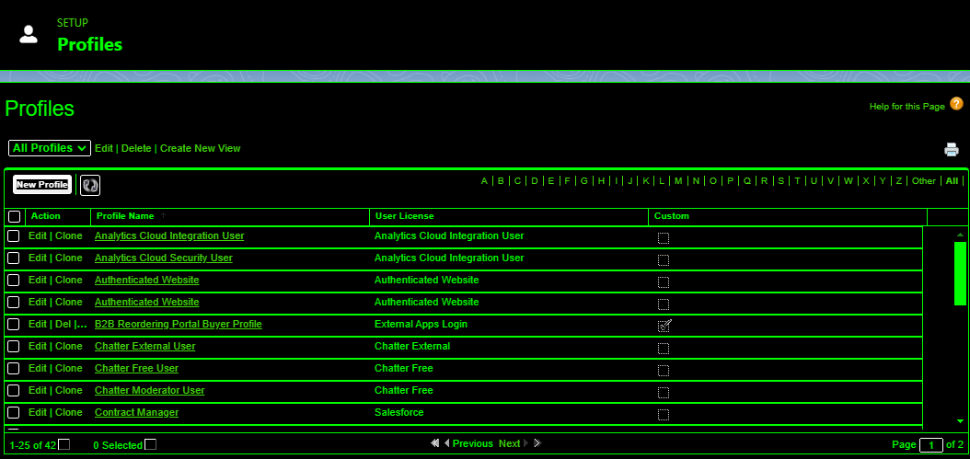
TASK – 3
Innovation and Problem solving:

